Slide 1
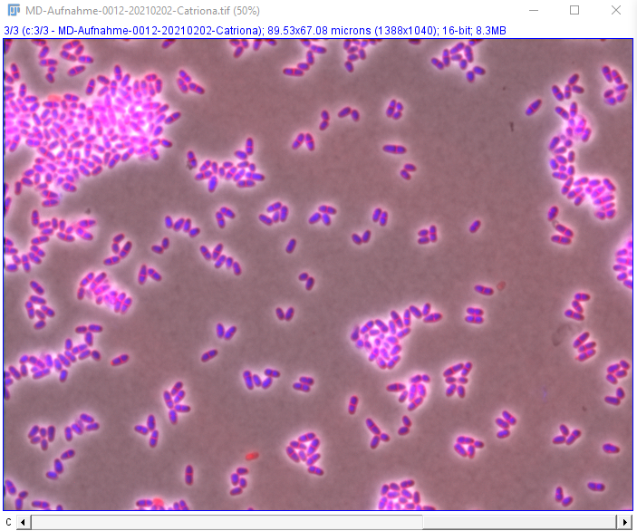
Requires:
Aligned Channels
Fiji
ProfilingCells_EPI.ijm macro

Slide 2
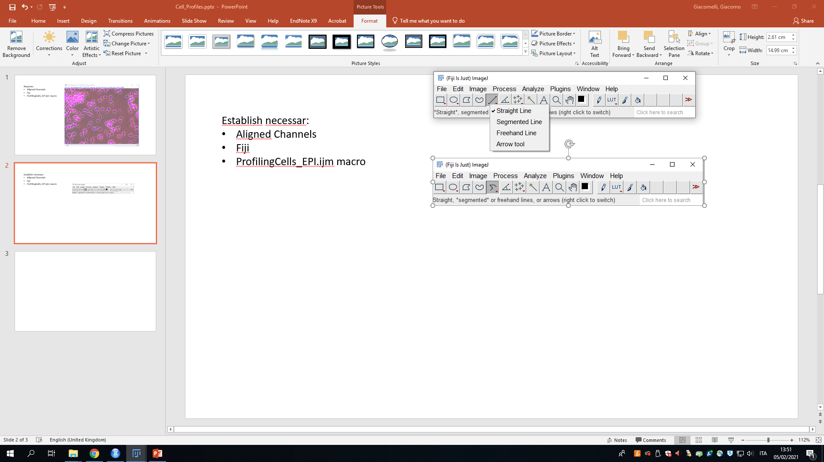
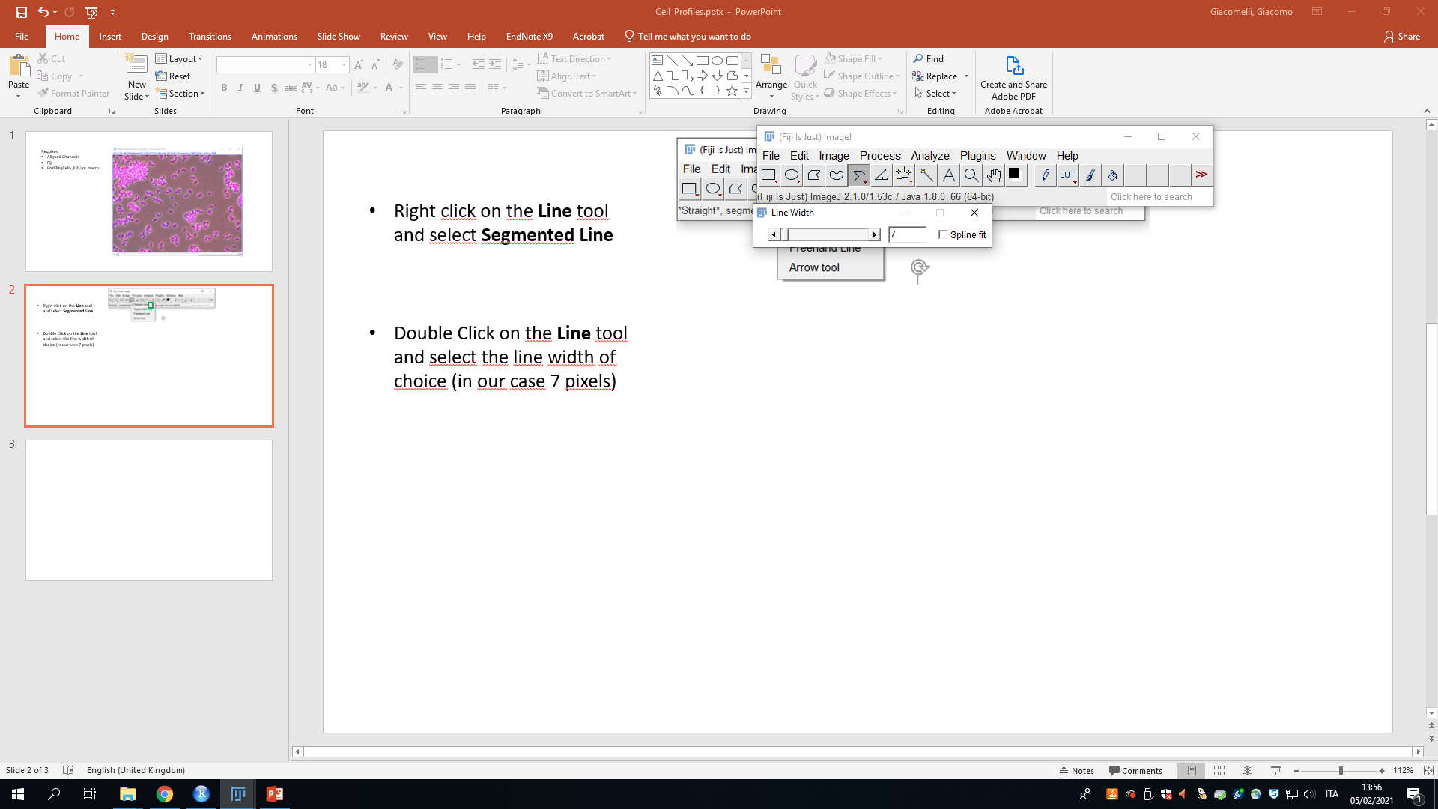
Setting up the tools
Right click on the Line tool and select Segmented Line
Double Click on the Line tool and select the line width of choice (in our case 7 pixels). Leave the Spline fit box unchecked.
Start a Segmented line by left clicking on the image, add a point to the segmented line by left clicking. The end point is selected by right clicking on the image

Slide 3
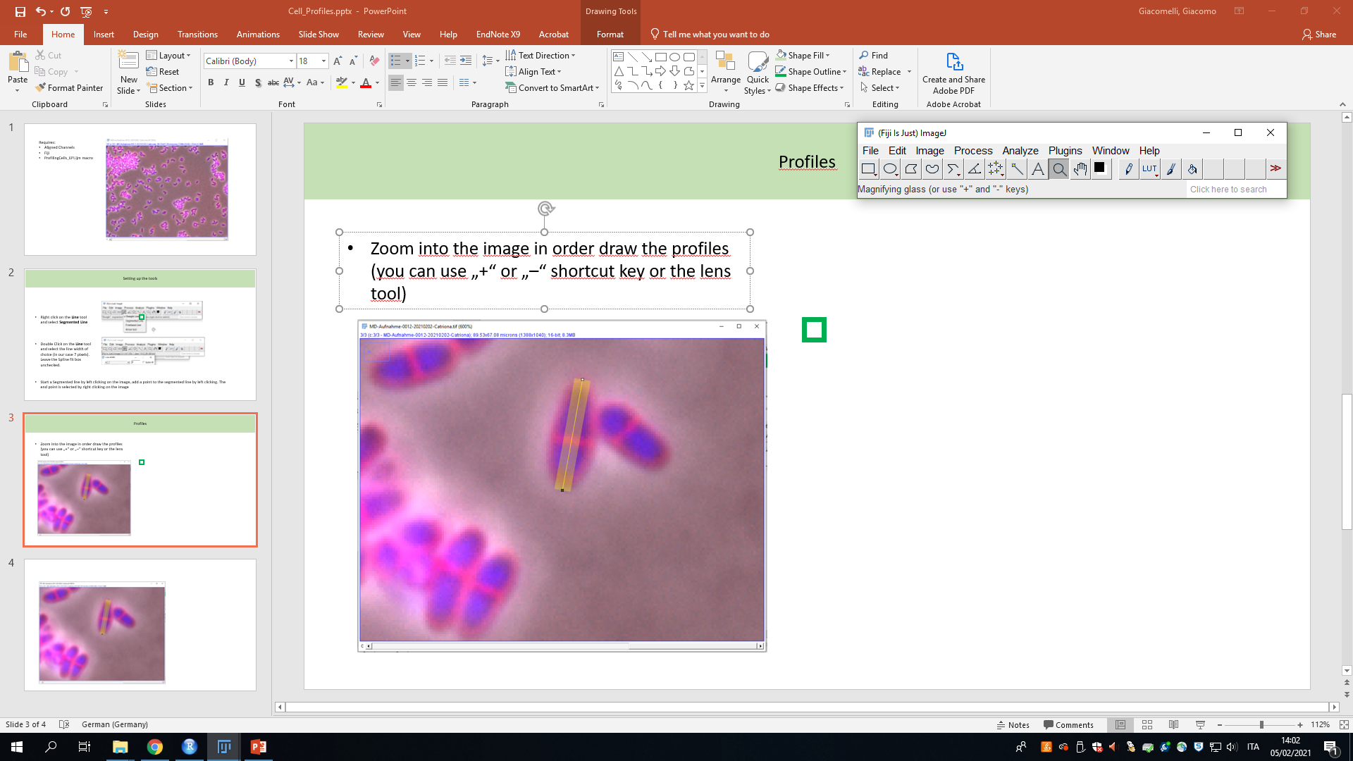
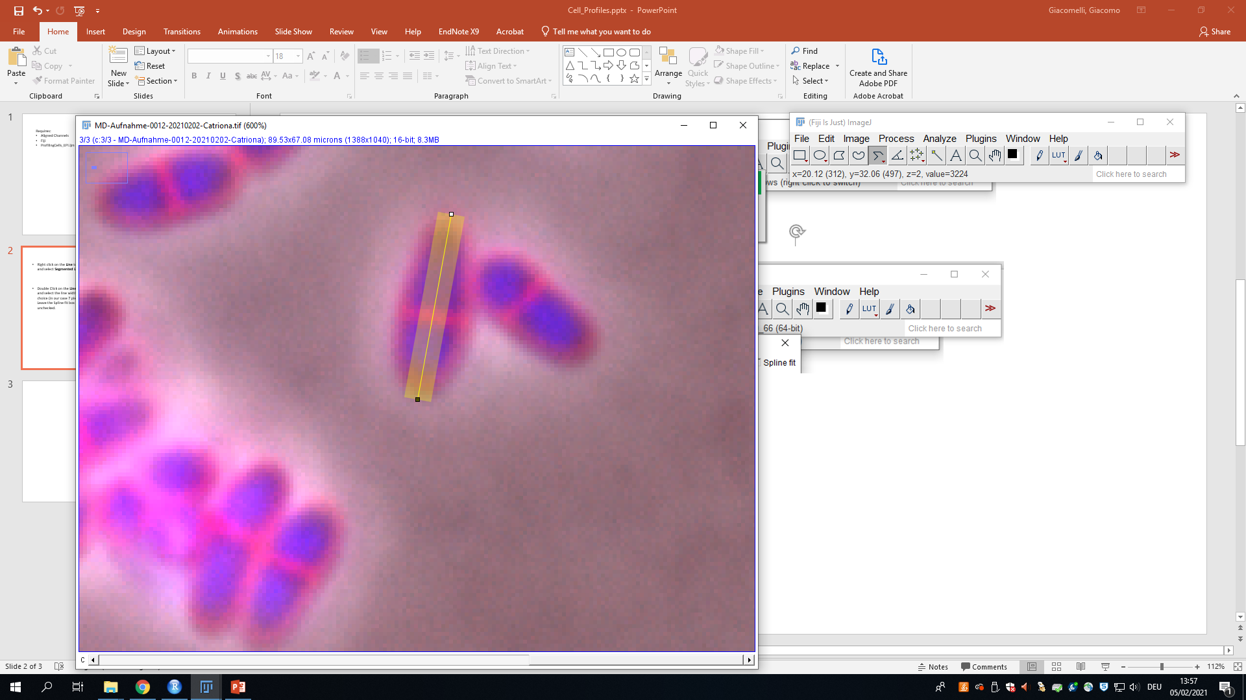
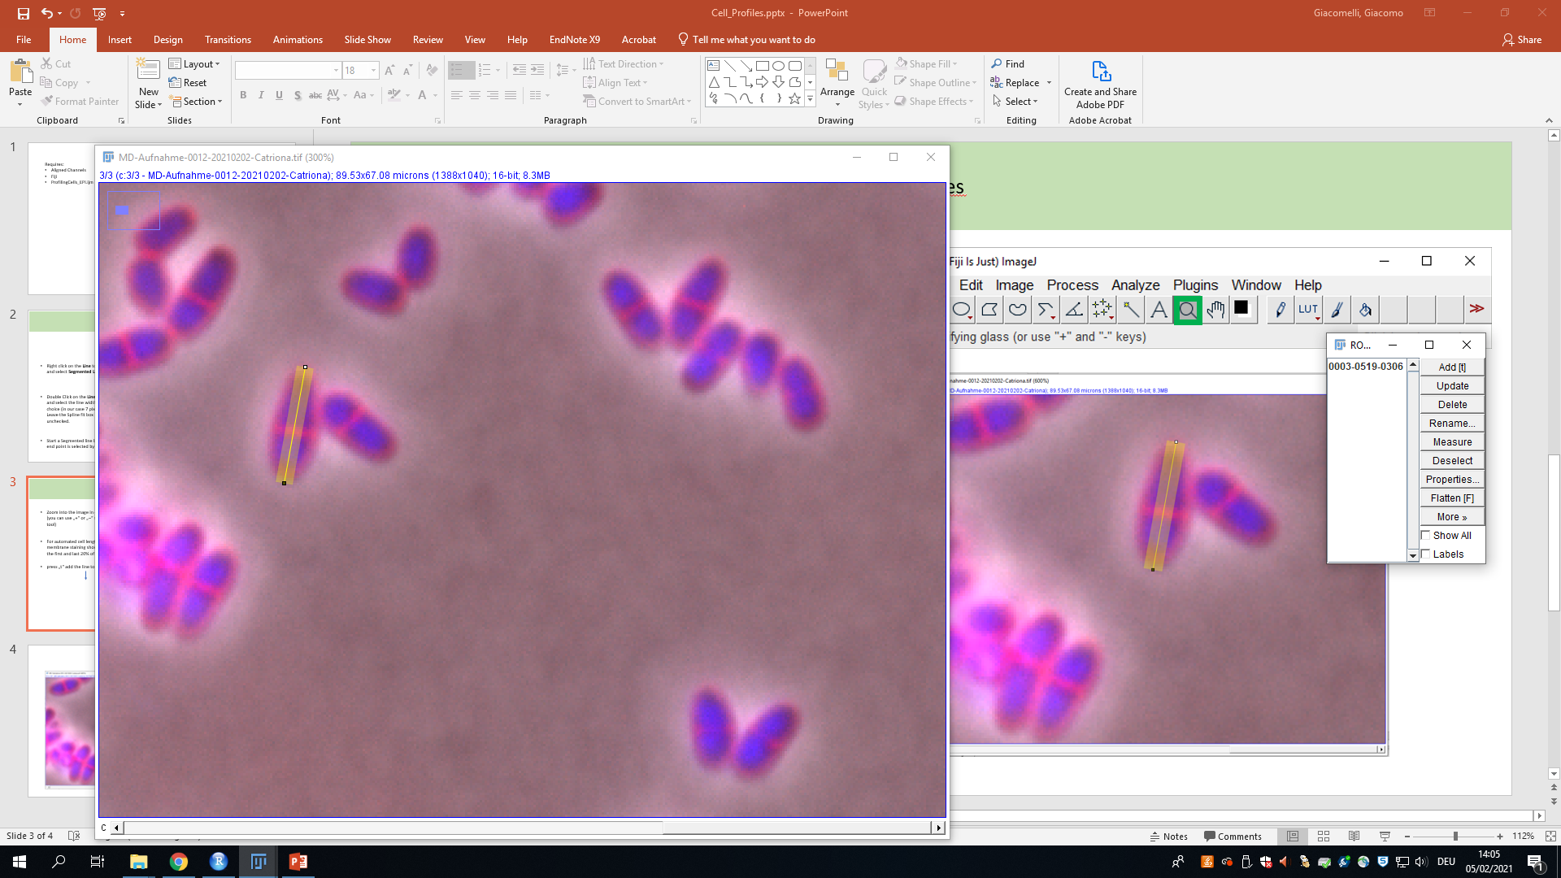
Draw the Profiles
Zoom into the image in order draw the profiles (you can use „+“ or „–“ shortcut key or the lens tool)
For automated cell length determination, the membrane staining should be included within the first and last 20% of the drawn line
press „t“ add the line to the ROI manager

Slide 4
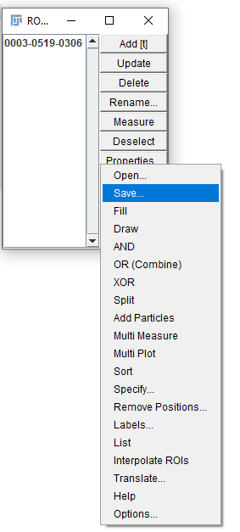
Save the regions of interest (ROIs)
Once you added all the segmented lines for the current image to the ROI manager, press Deselect on the ROI manager, the More>> and Save..
Save the RoiSet.zip with numerical increments according to the image (RoiSet1.zip, RoiSet2.zip, ...) within the folder containing the images. This will allow you to reopen the regions of interest at will

Slide 5
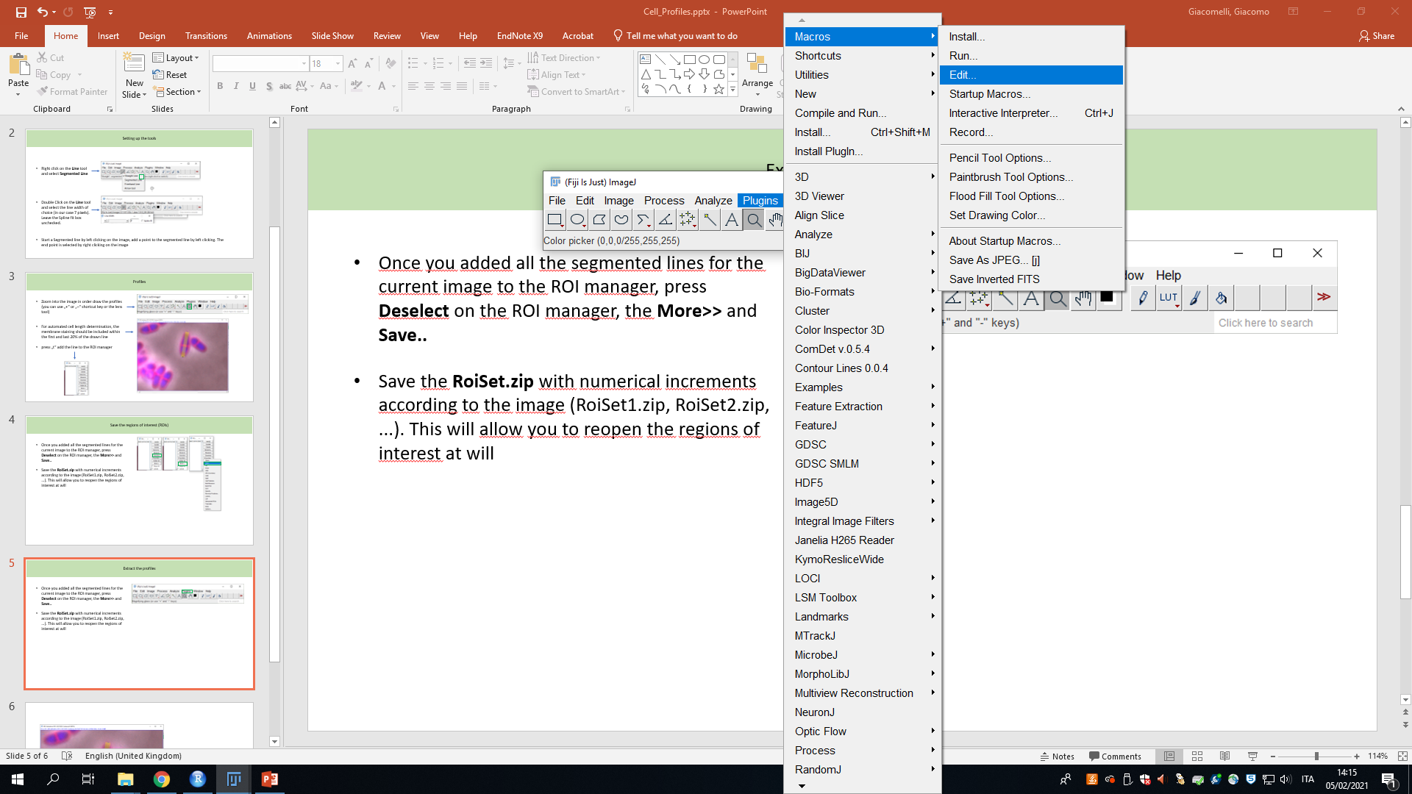
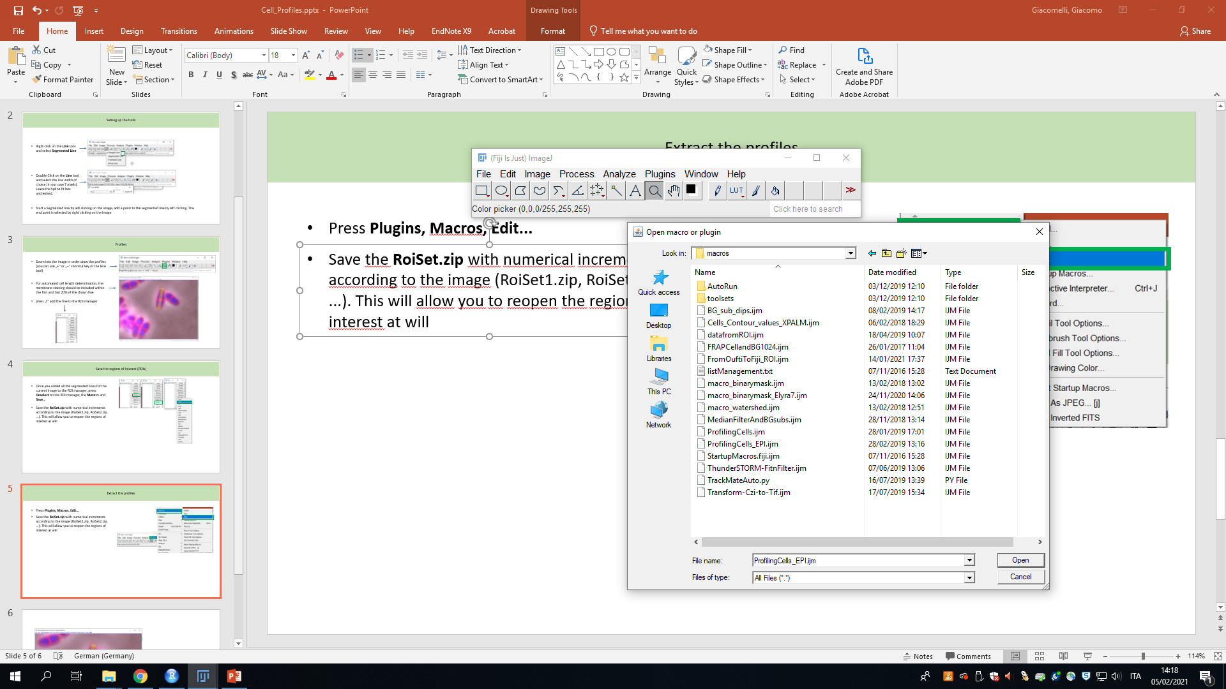
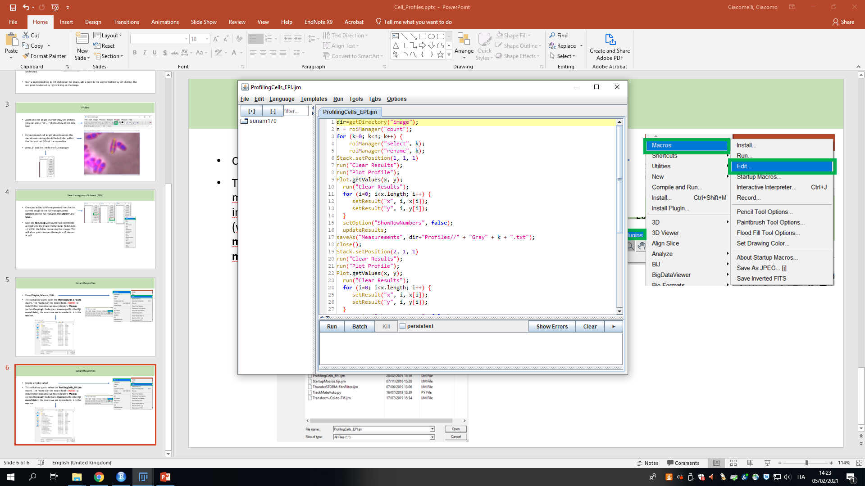
Extract the profiles
Press Plugins, Macros, Edit...
This will allow you to open the ProfilingCells_EPI.ijm macro. The macro is in the macro folder. NOTE: Fiji install folder contains two macro folders: Macros (within the plugin folder) and macros (within the Fiji main folder), the macro we are interested in is in the macros.

Slide 6
Extract the profiles
Create a folder called Profiles in the folder that contains the image you are analysing.
Run the macro
Once the macro finishes running, rename the Profiles folder with an incremental number (Profiles1, Profiles2, ...)

Slide 7
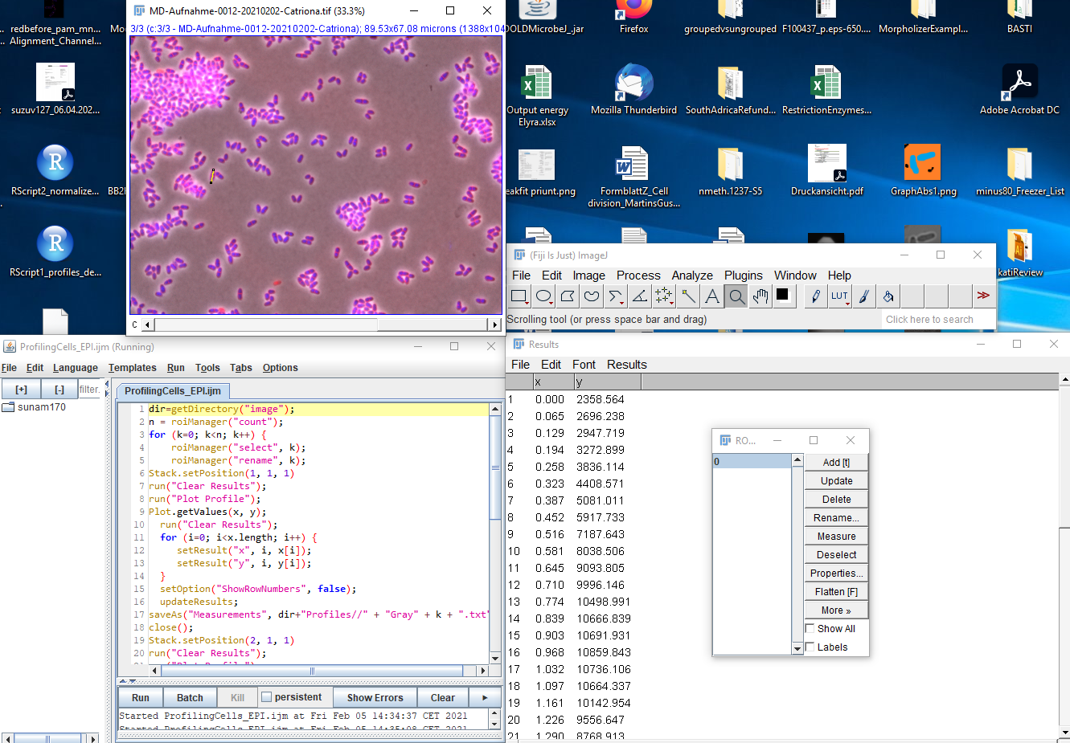
Reset the process
Delete the ROIs from the ROI manager (or close it), close the current image, and the Results table.
Leave open Fiji and the macro window

Slide 8
Move on
Open a new image and repeat the process. NOTE: remember to create a new Profiles folder for each image

Slide 9
Get ready
Open Rstudio
Open the “CPAD2_Cell_Profiles_And_Demographs_V3” script (in V3 version of the script you can chose between the cell by cell normalization and the population based normalization in the first few lines of code: “CellNorm” vs “PopNorm”)
NOTE: Analysis of “Profiles“ and “Membranes“ folders follow the same procedure. Profiles contained within the “Membranes” folder are obtained via the “CPAD1_Extract_Cell_length_from_membrane_stain_GG_Fiji_Macro.R” script.
NOTE2 (R basics):
Run parts of the script by selecting them with the mouse and then pressing “Ctrl + Enter”
Change/Select a working directory by pressing “Ctrl + Shift + H”
Code lines will not run when preceeded by a “#“. Activate/Deactivate part of the code with “#“

Slide 10
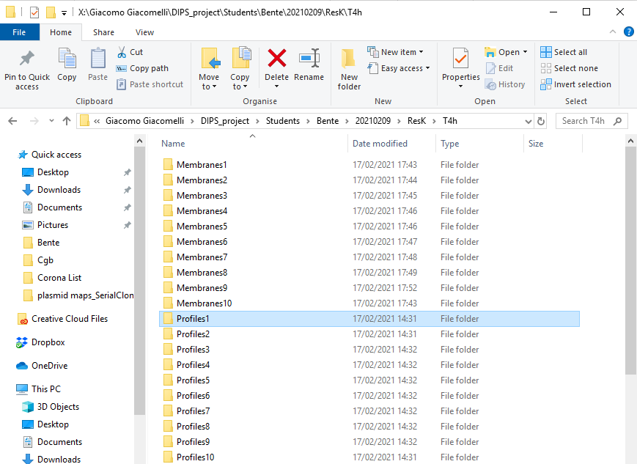
Set the working directory for the current analysis
Set as a working directory the folder that contains all the Profiles/Membranes folders “X:/Giacomo Giacomelli/DIPS_project/Students/Bente/20210209/ResK/T4h“

Slide 11
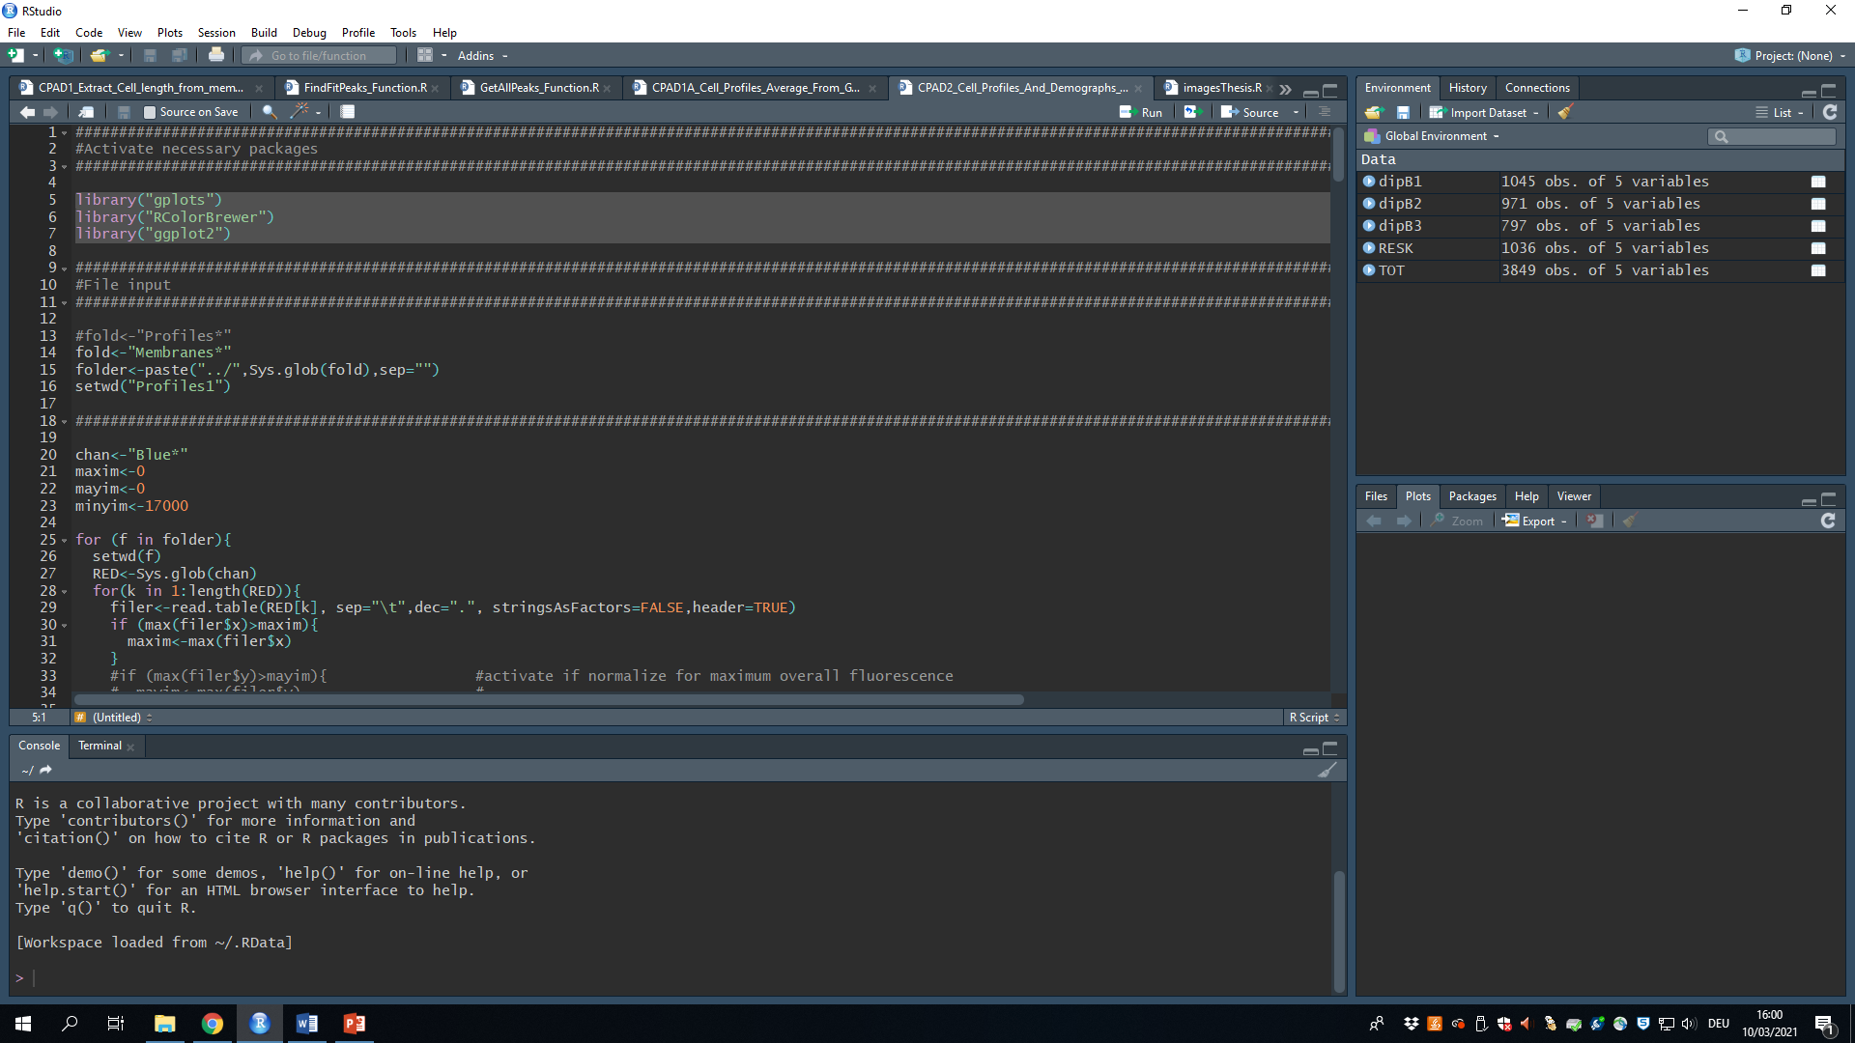
Activate/Install the necessary packages
StartUp the necessary packages (Run the lines of code shown in figure).
NOTE: If you are using R for the first time and you did not previously install the packages shown in figure, you first need to install them. In order to do so, run the following command:
install.packages(“gplots“)
install.packages(“RColorBrewer“)
install.packages(“ggplot2“)

Slide 12
Membranes vs Profiles analysis
Activate the desired analysis type (Profiles/Membranes) and deactivate the remaining one (use “#“).
Run the following command lines:
Set as a working directory any of the Profiles/Membranes folders by running the following command line:
Select the channel of interest (“Red*“,“Blue*“,“Gray*“ or whatever output was decided in the Fiji macro)
NOTE: the name of the file does not necessarily correspond to the actual color of the channel.
Before running the rest of the script, you need to decide the output of choice and the binwidth:
Binwidth needs to be bigger than the smaller interval between x values (in EPI 100/200 nm should be fine)

Slide 13
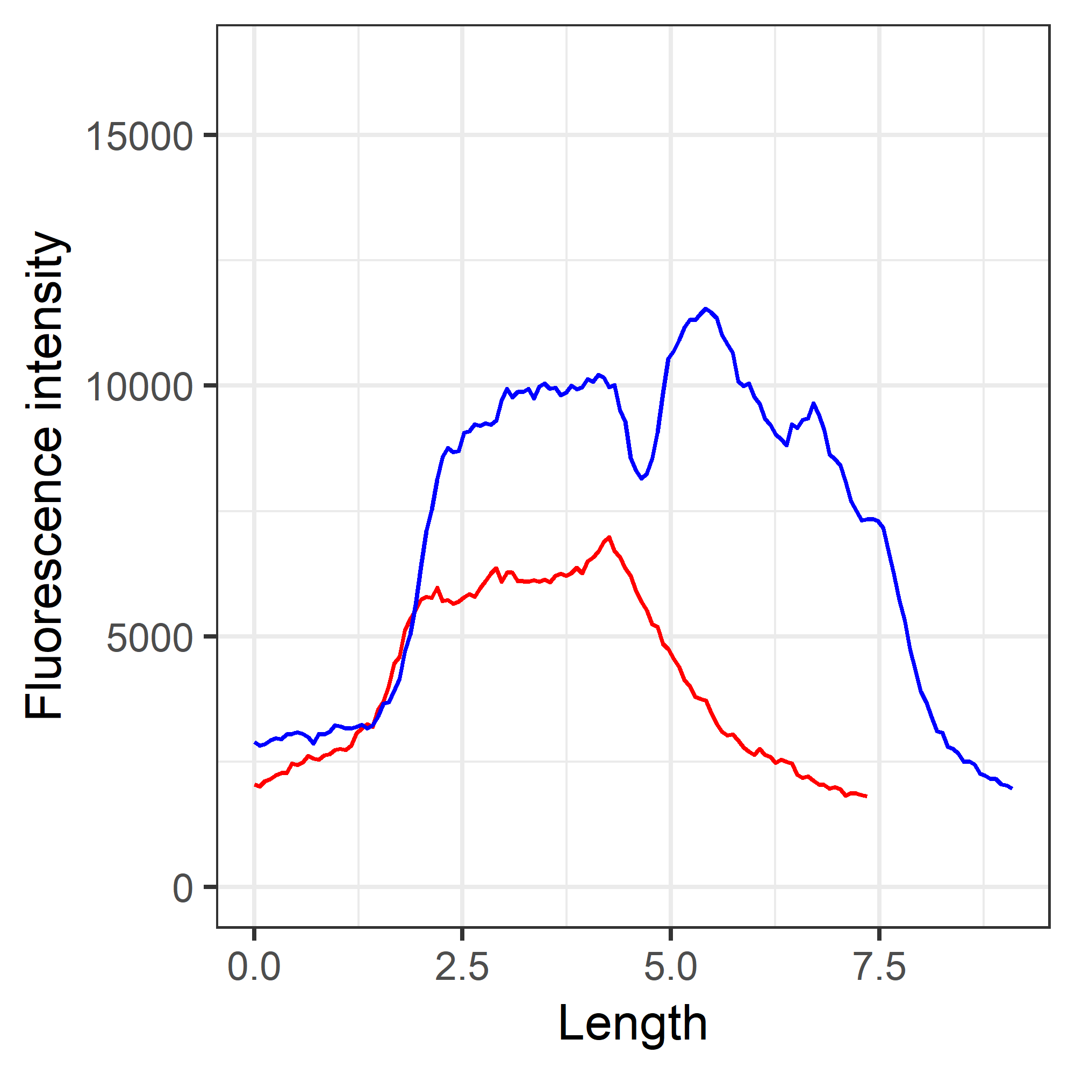
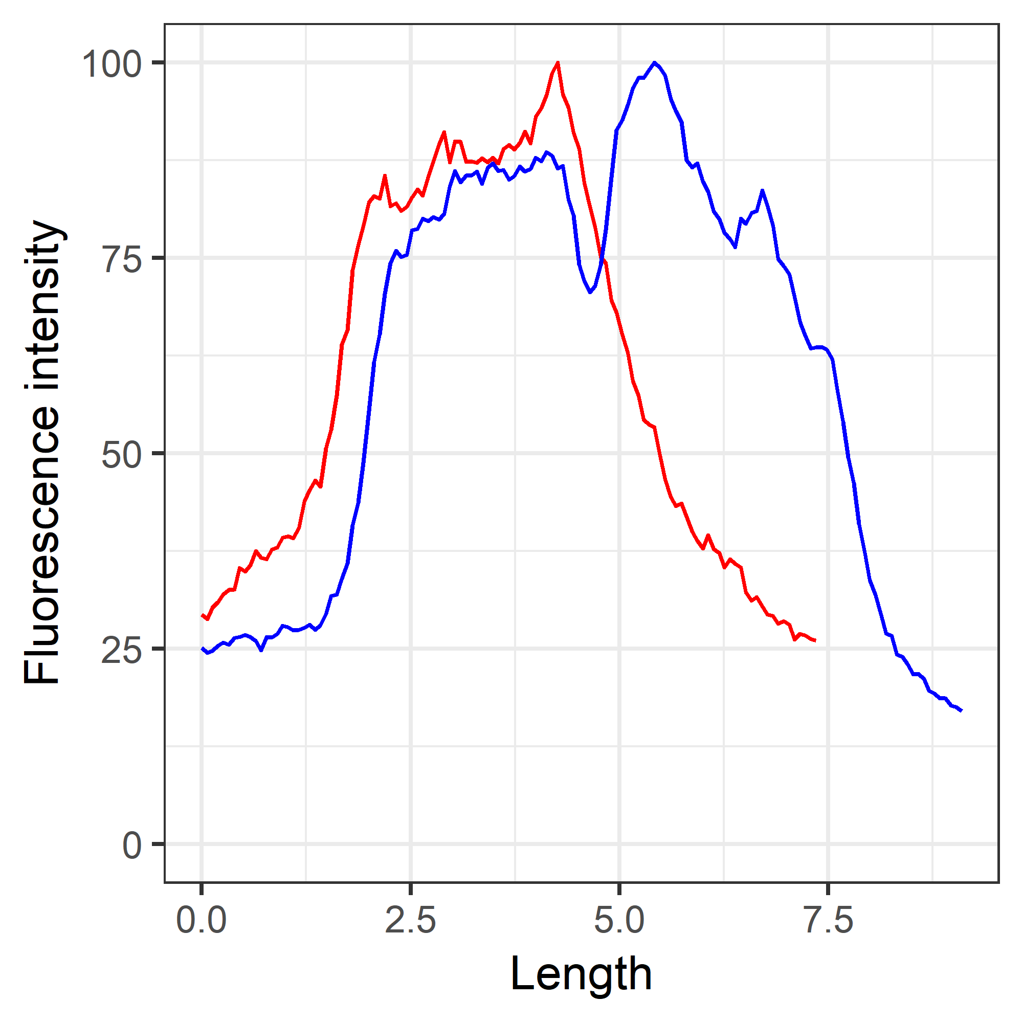
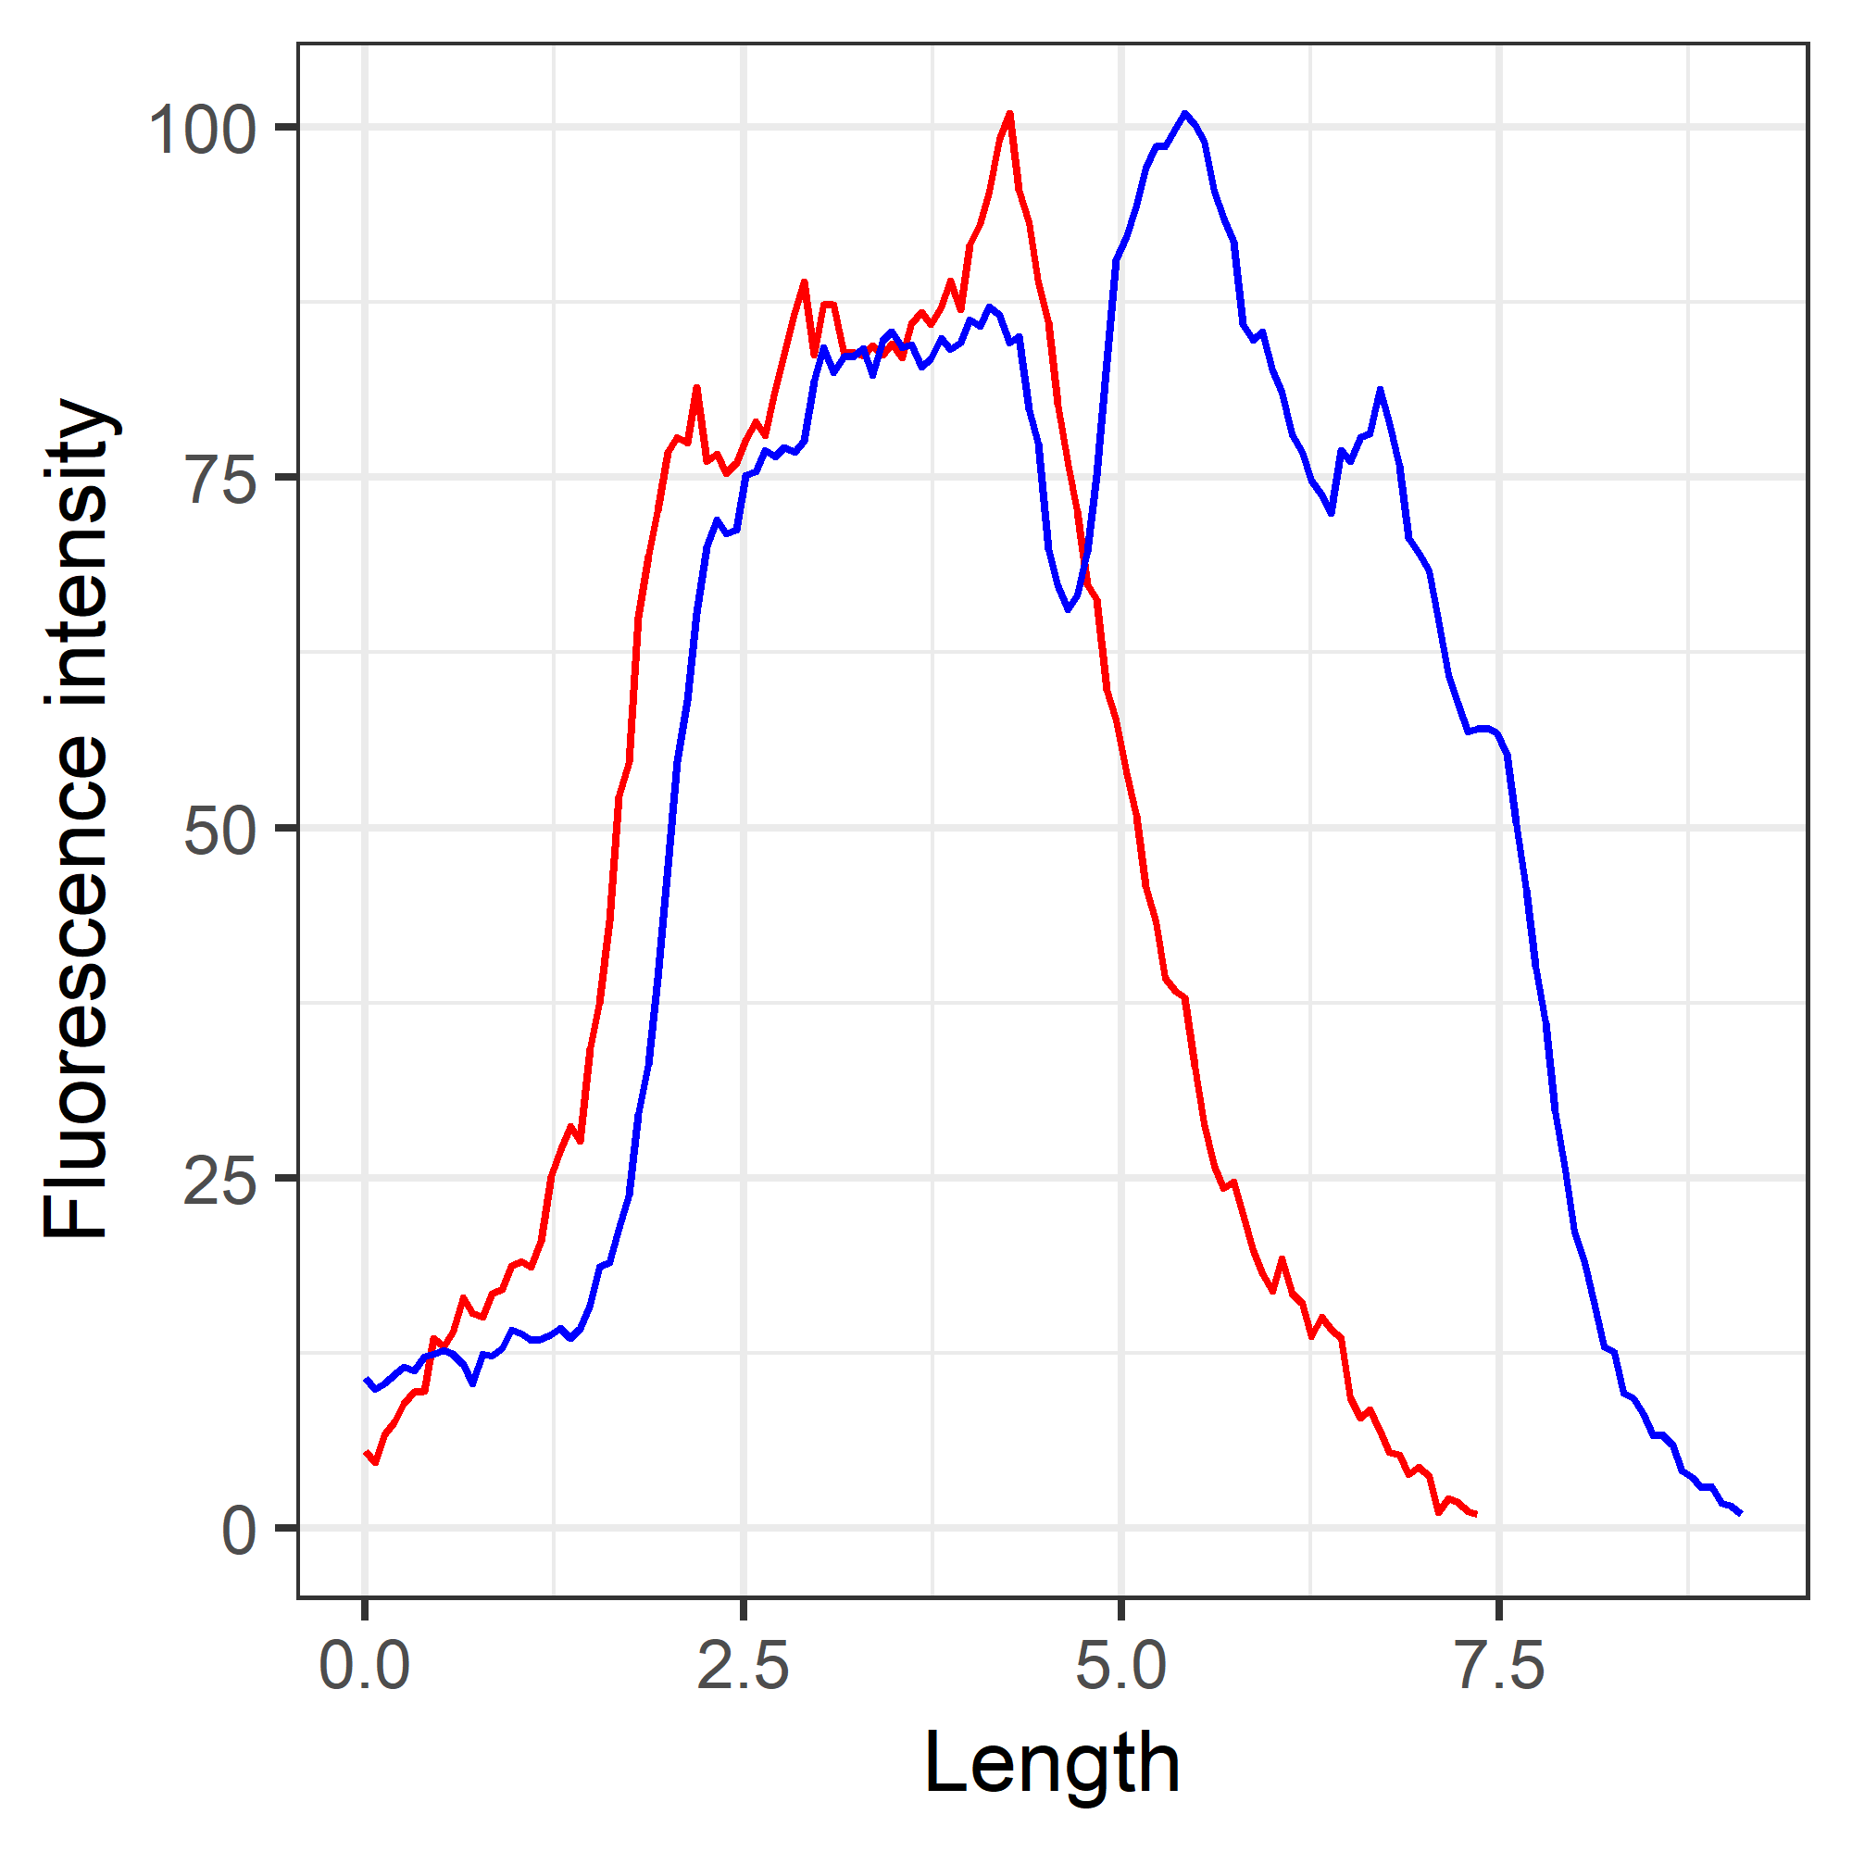
Cell by cell determination of the dynamic range (optimal for localization determination)
Original Profiles:
No correction
Scale: 0-16838
Cell 1: Red
Cell 2: Blue
Max determined for each cell individually
m*100/mayim
Scale: 0-100
Cell 1: Red
Cell 2: Blue
Max and Min determined for each cell individually
1+(m_c*100/mayim_c)
Scale: 0-100
Cell 1: Red
Cell 2: Blue

Slide 14
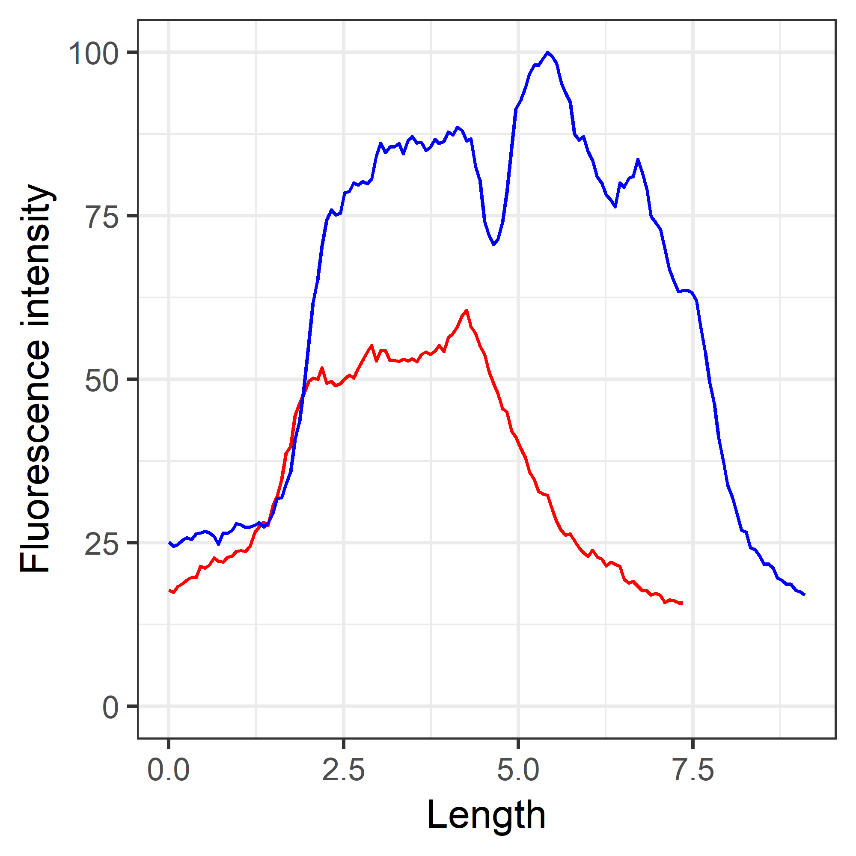
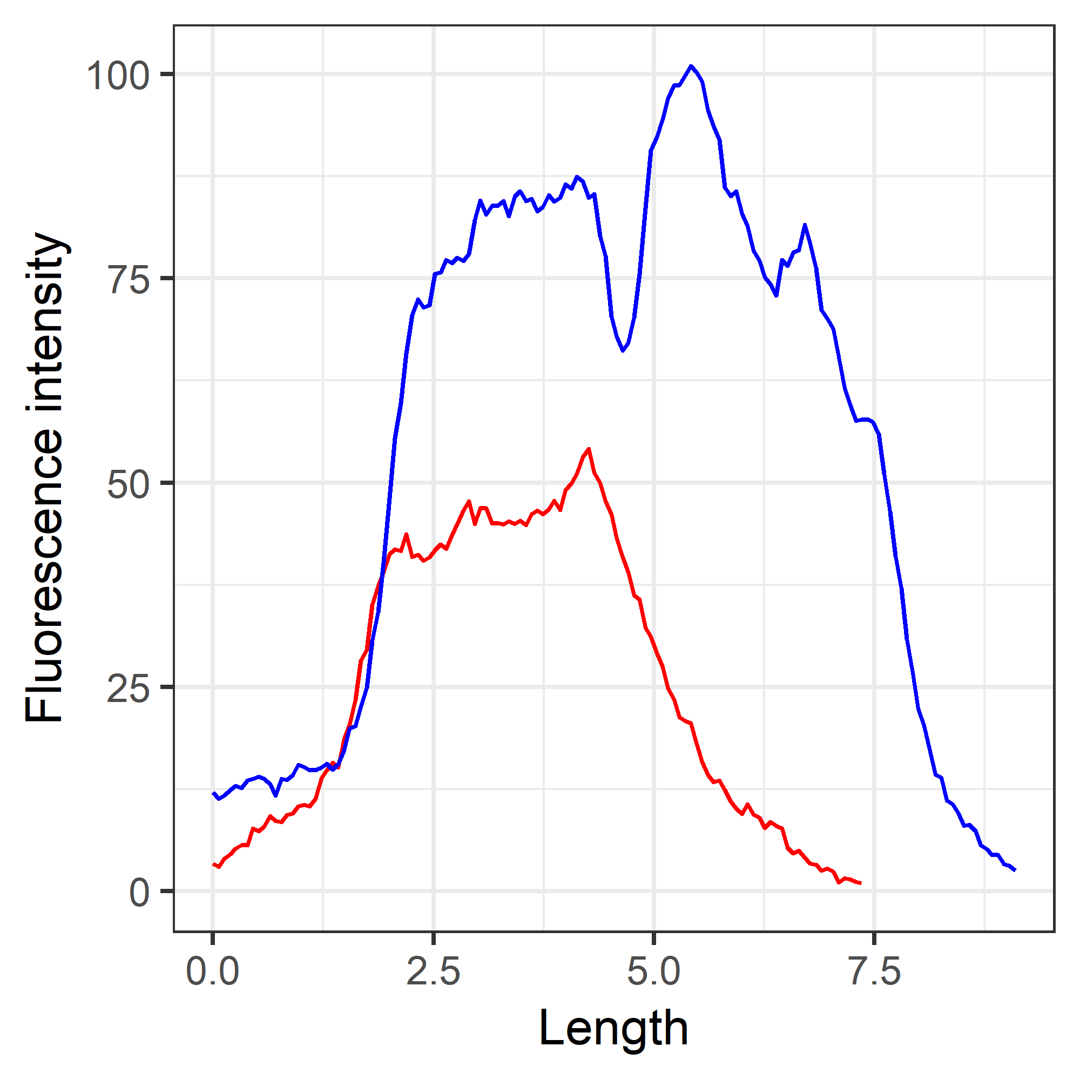
Population based max and min determination of the dynamic range (optimal for cell phase analysis)
Original Profiles:
No correction
Scale: 0-16838
Cell 1: Red
Cell 2: Blue
Max determined across the whole population
m*100/mayim
Scale: 0-100
Cell 1: Red
Cell 2: Blue
Max and Min determined across the whole population
1+(m_c*100/mayim_c)
Scale: 0-100
Cell 1: Red
Cell 2: Blue

Slide 15
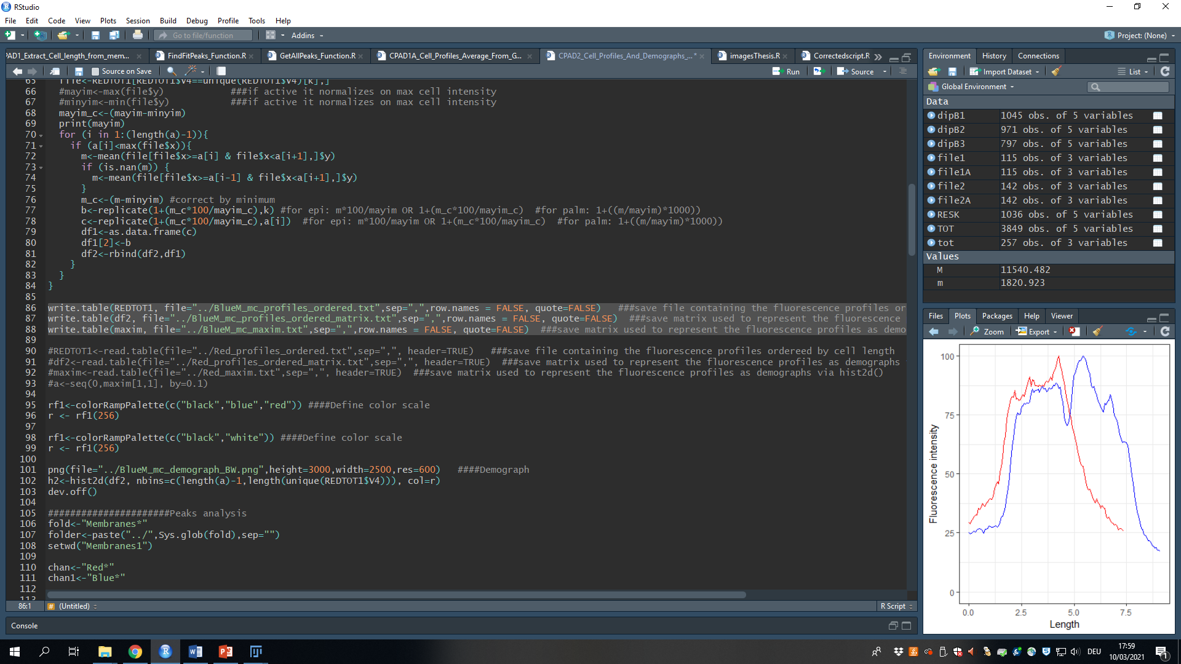
Save the output (and import it back)
Name the three output files as you wish, however I suggest you use the following structure:
REDTOT1-> “../whatever_ordered.txt“
df2->“../whatever_ordered_matrix.txt“
maxim->“../whatever_maxim.txt“
These three files are necessary in order to reimport the data in the future. In order to re-open old files activate and then run the following commands (make sure you are in the correct folder when trying to open files if you did not already specify the entire path):

Slide 16
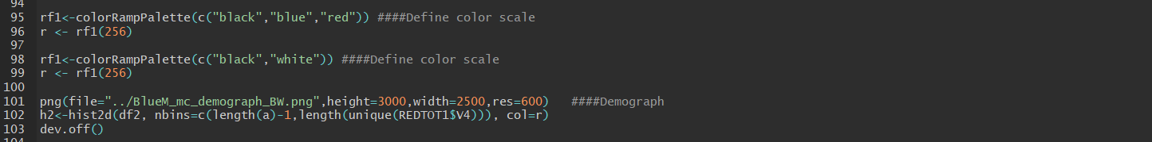
Plot and save the kymograph
Select the scale of choice:
The plotting command will use the last activated scale for the kymograph. You can find more colors here or use hexadecimal codes. By repeating a color name multiple times you can compress the color gradient to different values.
Remember to change the name of the png file to the name of choice prior to saving it (it will overlap files with the same name if present)
NOTE: you can change the height, width and resolution of the image in the png command.
Blue-Red scale
Gray Scale

